Slide 1
WELCOME
WENTWORTH RESORT
CONDOMINIUM ASSOCIATION OWNERS
2016 ANNUAL MEETING

Slide 2
AGENDA
Welcome / Notice / Quorum / 2015 Minutes Dan Coughlin
Summary of Major Activities Dan Coughlin
Capital Improvement Plan Erik Chandler
Financial Implications of Capital Plan John Sevee
Financial Review of 2016 & 2017 Budget John Sevee
Election of Board Members Dan Coughlin
Real Estate Kathleen Sullivan Head
Around Town DD Warren

Slide 3
Welcome 2016
Dan Coughlin
Proof of Notice
Determination of Quorum
Approval Meeting Minutes 12/5/2015

Slide 4
2016 MAJOR ACTIVITIES
Property line survey by White Mtn. Survey
Amendment to Condominium Documents
3 Year renewal of the Property Management Contract
Capital Improvement Program
$25 Per Quarter dues increase

Slide 5
Wentworth Dues History
Last Year Increase brought us in Line with 2% annual increase
Maintain the inflation adjustment to the dues at 2% for 2017
Ratio of dues to assessed value still 25% below competition
3 quarters of the 8 quarter assessment behind us
Probability that assessment will be extended beyond 8 quarters due to unforeseen rot and need to build reserves

Slide 6
Capital Improvements
3 Rs: Rot, Roof, and Repairs
BRL List – Inherited when hired and conducted owner survey
Erik Chandler

Slide 7
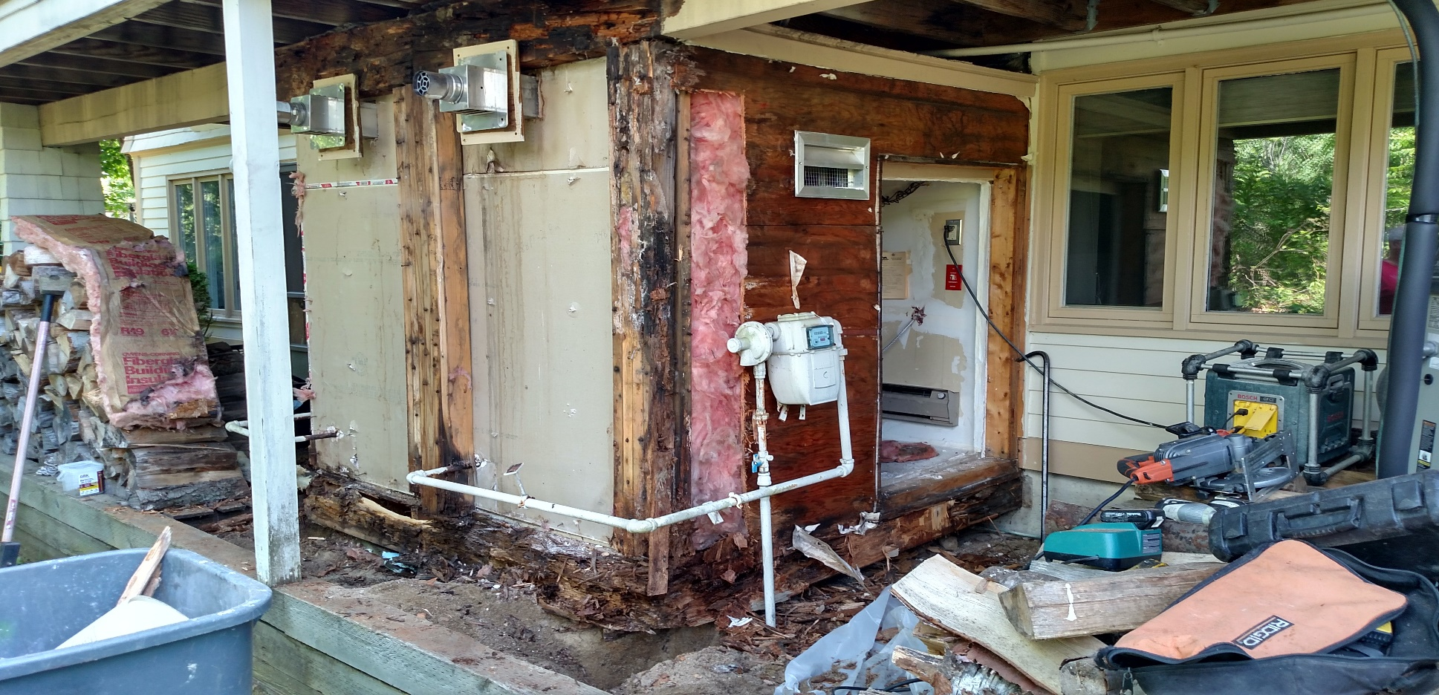
Capital Improvement Plan
Erik Chandler
Pictures
Pictures

Slide 8
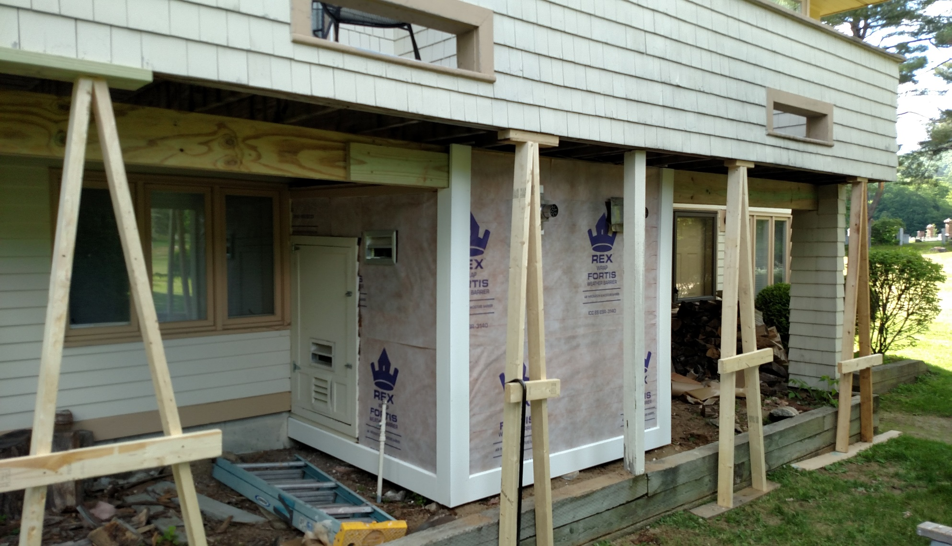
Capital Improvement Plan
Erik Chandler

Slide 9
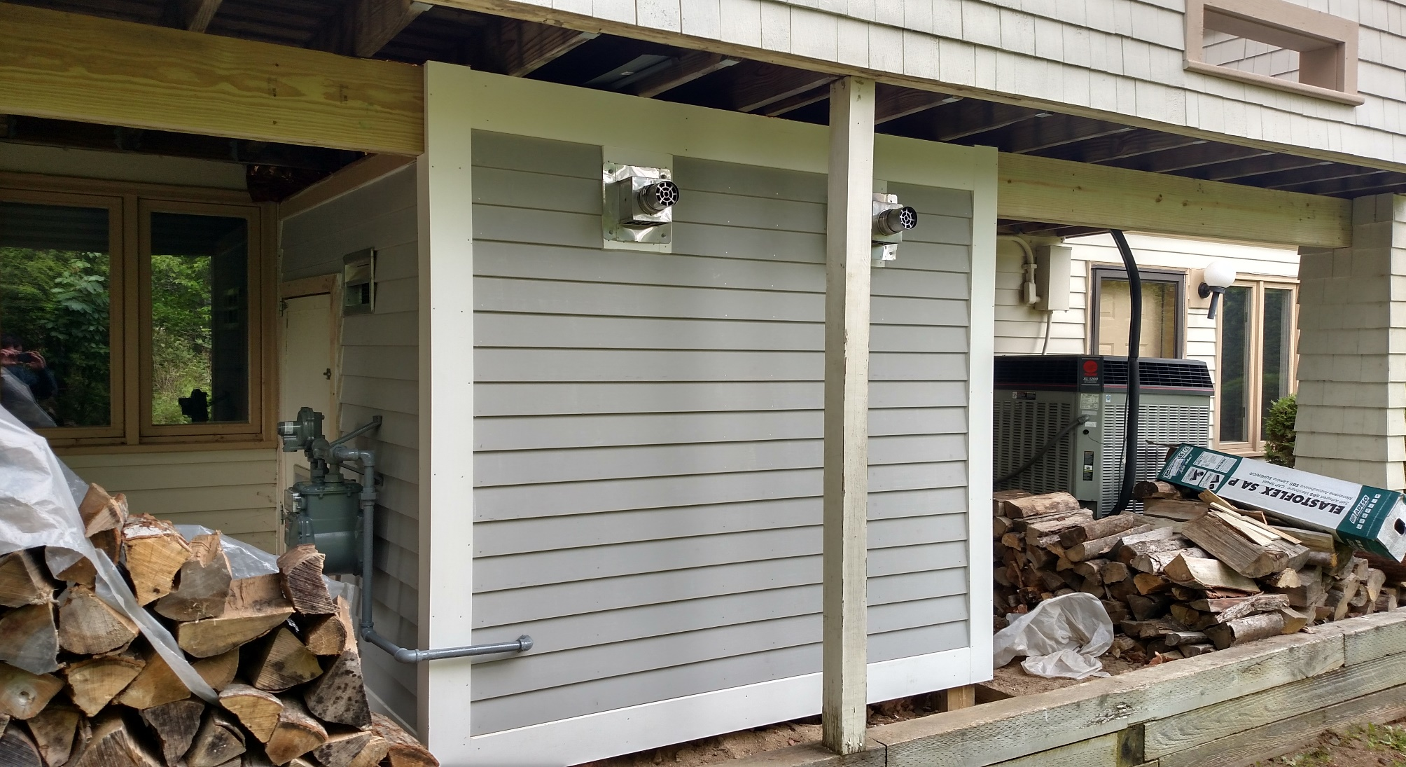
Capital Improvement Plan
Erik Chandler

Slide 10
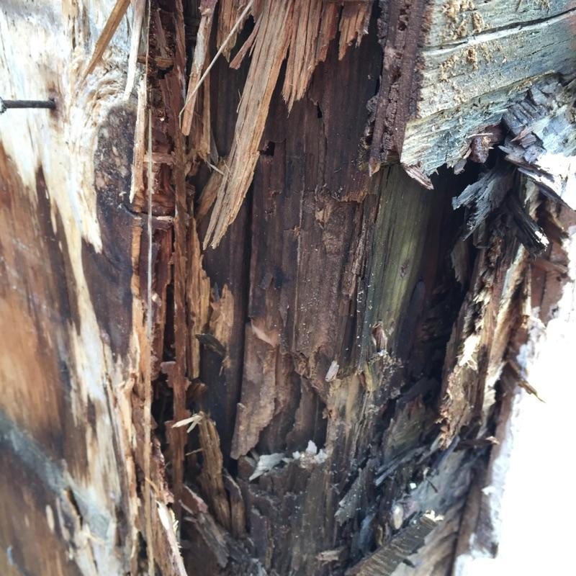
Capital Improvement Plan
Erik Chandler

Slide 11
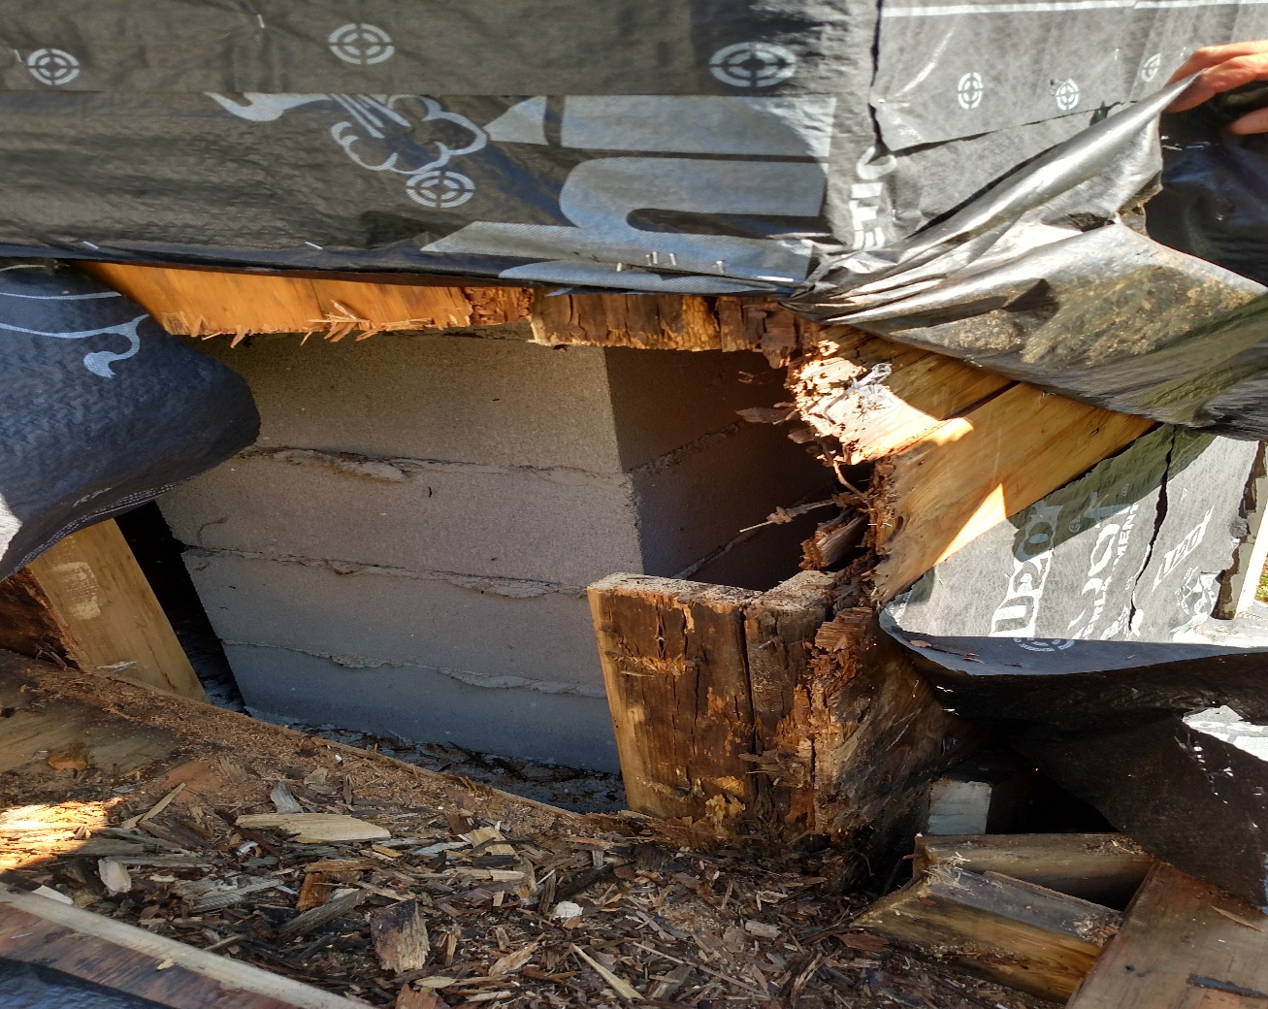
Capital Improvement Plan
Erik Chandler

Slide 12
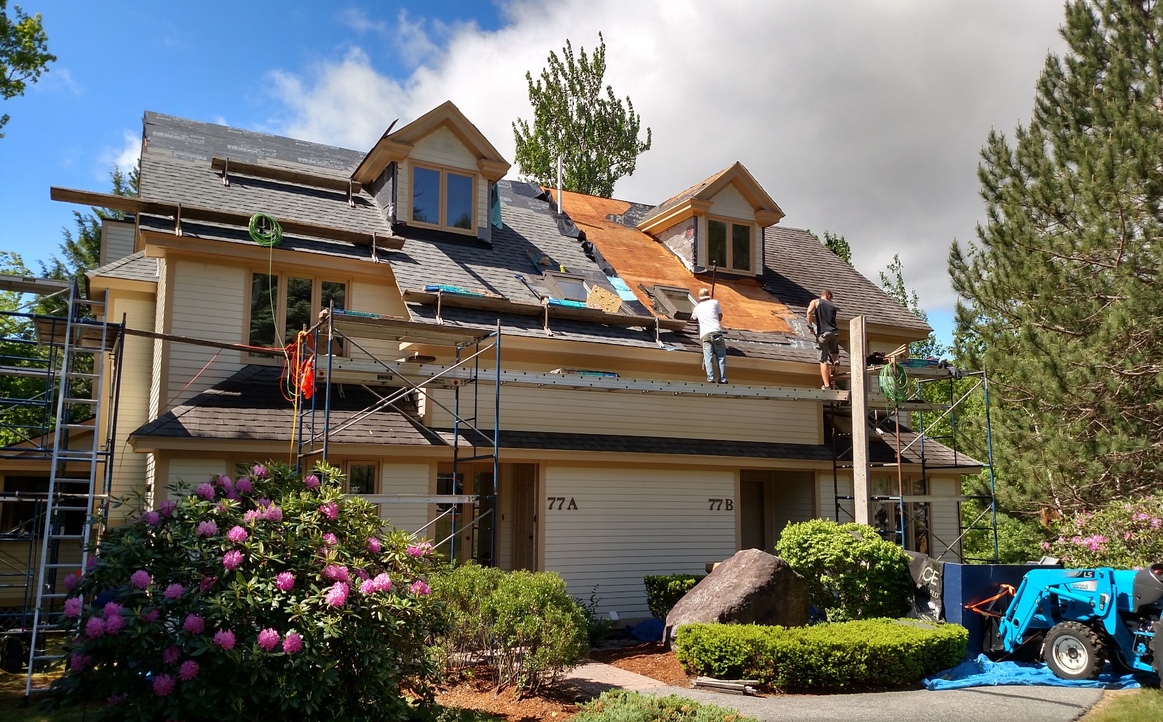
Capital Improvement Plan
Erik Chandler

Slide 13
FINANCIAL IMPLICATIONS OF CAPITAL PLAN
John Sevee

Slide 14
Where did the 2016 Dollars Go ???
John Sevee
Chimney Repair | $ 19,415
Painting | $ 49,602
Roads / Walkway | $ 27,996
Roofing | $ 55,235
Rot Work | $ 141,228
Tree Work | $ 28,143
Total Capital Expenditures |  | $ 321,620

Slide 15
Where will 2017 funds be spent?
John Sevee
 |  |  | Rot
Building | Total | Roofing | Work | Painting | Contingency
5 Fairview | 73,000.00 | 34,500.00 | 20,000.00 | 13,500.00 | 5,000.00
Building 29 | 69,000.00 | 44,000.00 | 10,000.00 | 9,500.00 | 5,500.00
Roof, Skylight ,rot ,paint
Building 14 Joshua
Chimney Chase | 12,500.00 |  | 12,000.00 |  | 500.00
13 Chipper
Roofing - Rear | 20,000.00 | 20,000.00
Building 9
roofing rear *** | 20,000.00 | 20,000.00
Building 17
Roofing rear*** | 20,000.00 | 20,000.00
Building 31
roofing rear*** | 20,000.00 | 20,000.00
Hurlin
Furnace building rot | 10,000.00 |  | 10,000.00
 | 244,500.00 | 158,500.00 | 52,000.00 | 23,000.00 | 11,000.00
***For completion in the fourth quarter of 2017- the first quarter of fiscal 2018

Slide 16
Financial Review
John Sevee
 | 2016 | 2016 | 2016 Actual | 2016 Comments | Proposed
 | Budget Col. 1 | Actual Col. 2 | vs Budget (%) (Col. 2- Col.1) / Col.1 |  | 2017 Budget
Revenues | $446,000 | $447,000 | 101 | 2% Dues Increase, 3/4 year assessment | $487,000 Includes full year assessment
Contracts | $169,000 | $170,714 | 101 | Insurance increase | $173,040
Building Maintenance | $36,000 | $19,910 | -45 | Variance covered by capital | $37,500
Grounds Maintenance | $9,000 | $7,788 | -14 | Variance in capital | $6,000
Utilities | $23,000 | $26,330 | 115 | septic pump | $25,100
 |  |  |  | replacement
Other Miscellaneous | $6,000 | $15,244 | 254 | Legal fees | $9,420
Reserves | $38,000 | $0 | - | Used for capital | $60,000
CAPEX | $165,000 | $321,620 | 195 | Roof and BRL | $157,000
Net Cash Flow | $0 | ($114,606) | n/a | Net Reserves Depleted | $0

Slide 17
Financial Review
John Sevee
IMPORTANT 2017 GOALS
John Sevee
Continue Building Repairs
File the document amendment
Maximize impact and Minimize Future Capital Costs
Address the Reserve Deficiency

Slide 18
Election of Officers
Dan Coughlin
SLATE OF NOMINEES
2 Expiring terms this year
John Sevee -5 Fairview
Jack Rowe - 20 Cottage Drive
Nominations from the floor ???
A BIG THANK YOU to:
ROSEMARY O’BRIEN
for 8 YEARS of TIRELESS SERVICE !

Slide 19

Real Estate
Kathleen Sullivan Head

Slide 20
Going On Around Town
DD Warren
Santa Holiday Express – Conway Scenic RR
Jingle Bell Tour – Jackson Village – 11 am to 4 pm
  call Chamber for info 383-9356
Photos with Santa – Settlers Green – 10 to 2 pm
Shop Till You Drop …….. Settlers Green Tree Festival

Slide 21
DINNER TONIGHT
THANK YOU !
5:30 PM Cocktails
6:30 PM Dinner
Wentworth Hotel

