Slide 1
WELCOME
WENTWORTH RESORT
CONDOMINIUM ASSOCIATION OWNERS
2019 ANNUAL MEETING

Slide 2
Annual Meeting Agenda
Welcome / Notice / Quorum / 2018 Minutes Dan Coughlin
Progress on 2019 Major Goals Dan Coughlin
Operating and Capital Budget John Sevee
Capital Budget Study John Sevee
2020 Major Goals Dan Coughlin
Election of Board Members Blake Smith
Real Estate Kathleen Sullivan Head
Around Town DD Warren

Slide 3
Welcome 2019
Proof of Notice
Determination of Quorum
Approval Meeting Minutes 12/1/2018

Slide 4
Results of 2019 Board Goals
Operate the Association within the Operating budget- done.
On the capital budget side there are still residual issues which will be addressed– continuous goal.
Maintain the property on a stable basis with stable dues and capital structure—assessment finished, dues increases to compensate for cost of living increases over time, and beginning to restore reserves.
Deep dive on all operating costs to seek economies of scale—done--operating contracts reviewed, scope of service modified, replacement capex study completed.
Establish Design Review Committee-to supervise modifications to the appearance of the Condominium, establish specifications, review request form and approve contractors list.
Identify the most effective way to manage the impact of the social media rental programs, such as, AirBnB, VACASA etc.—vigilance

Slide 5
BUDGET SUMMARY
 | 2019 | 2019 | 2019 Actual | Proposed | Comments
 | Actual | Budget | vs Budget (%) | 2020 Budget
Revenues | $ 492,238 | $ 495,200 | 99 | $ 451,200
Contracts | $ 170,047 | $ 173,440 | 98 | $ 176,440
Building Maintenance | $ 67,312 | $ 36,500 | 184 | $ 73,000 | Roof snow and ice removal
Grounds Maintenance | $ 8,545 | $ 6,000 | 142 | $ 6,000 | Snow damage cleanup
Utilities | $ 22,662 | $ 41,100 | 55 | $ 32,100 | Over-budgeted for septic repair
Other Miscellaneous | $ 3,341 | $ 9,500 | 35 | $ 5,500
Reserves | $ 51,000 | $ 31,500 | 162 | $ 45,000 | Likely used on Capex
CAPEX | $ 201,134 | $ 197160 | 102 | $ 113,160

Slide 6
2019 RESTORATION HIGHLIGHTS
Skylight at 3B Fairview
Boiler shed repairs and roofing at 10 Joshua
Rot repair of 7 Hurlin, 82 Wentworth, 10 & 14 Joshua,
12 Cottage and 13 Hurlin
Roofing of 7 Hurlin and 13 Hurlin
Chimney repairs, relining and rebuilds at 13 Hurlin,
20B & C Cottage and 29B & C Wentworth
Painting of buildings at 20 Cottage, 7 Hurlin and 13 Hurlin

Slide 7
RESTORATION COSTS
2016 through 2019
 |  | 2016 | 2017 | 2018 | 2019 | TOTAL | PER UNIT
ROOFS |  | $120,353 | $58,282 | $144,259 | $63,515 | $386,409 | $4,830
CHIMNEYS |  | $20,455 | $16,540 | $23,661 | $18,000 | $78,656 | $983
PAVING |  | $27,996 | 0 | 0 | 0 | $27,996 | $350
PAINTING |  | $49,602 | $17,008 | $31,707 | $59,123 | $157,440 | $1,968
TREE REPAIR |  | $28,143 | 0 | 0 | 0 | $28,143 | $352
SUBTOTAL |  | $246,549 | $91,830 | $199,627 | $140,638 | $678,644 | $8,483
ROT |  | $169,208 | $133,315 | $147,105 | $158,496 | $608,124 | $7,602
MOLD |  | 0 | 0 | $936 | 0 | $936 | $12
TOTAL |  | $415,757 | $225,145 | $347,668 | $299,134 | $1,287,704 | $16,096

Slide 8
CURRENTLY PROJECTED WORK STARTING IN FISCAL YEAR 2020
82C Wentworth boiler shed repair
17D Wentworth chimney work
17 Wentworth rear roof
17 Wentworth rot (contingency with roofing)
31 Wentworth rot repair prior to painting
31 Wentworth paint
82 Wentworth rear roof
82 Wentworth skylights
82 Wentworth painting
7C Hurlin chimney liner
3A Fairview railing rot

Slide 9
CURRENTLY PROJECTED WORK STARTING IN FISCAL YEAR 2021
77 Wentworth rot repair
77 Wentworth painting
14A Joshua chimney chase
10D Joshua chimney rot repair
66A Wentworth chimney chase

Slide 10
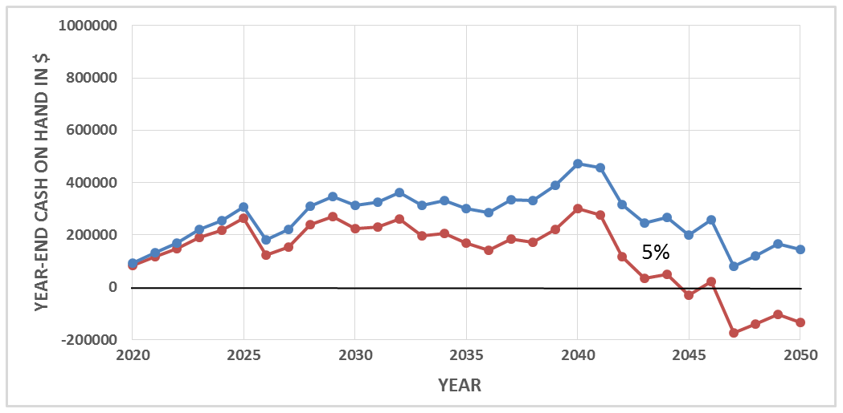
CAPITAL RESERVE FUND AT END OF YEAR
0%

Slide 11
2020 Board Goals
Operate the Association within the Operating budget.
On the capital budget side, we will have a revolving list of on going issues to be addressed.
Maintain the fiscal and financial stability of the association.
Implement contract changes to insure economies of scale and effective service levels.
Monitor property rental programs to minimize the impact of the social media rental programs—AirBnB, VACASA etc.

Slide 12
Election of Board Members
The Board encourages you to consider getting involved. The current board has served multiple terms and would encourage new ideas and participation.
Jack Rowe 2019
John Sevee 2019
DD Warren 2020
Cheryl Pizor 2020
Dan Coughlin 2020
Blake Smith 2021
Bob Michaud 2021

Slide 13
Real Estate Kathleen Sullivan Head

Slide 14
Going On Around Town DD Warren
Santa Holiday Express – Conway Scenic RR
Jingle Bell Tour Jackson Village – 11 am to 4 pm
Sold out but call Chamber for details (383-9356)
Photos with Santa – Settlers Green – 9 to 4 pm
Shop Till You Drop --Settlers Green Tree Festival

Slide 15
DINNER TONIGHT
THANK YOU !
5:30 PM Cocktails
6:30 PM Dinner
Red Fox

